Slide 1
Extra
Sums of Squares
An extra sums of squares measures the marginal reduction in the error sum of squares when one or several predictor variables are added to the regression model, given that the other predictor variables are already in the model.
Equivalently, we can view the extra sum of squares as measuring the marginal increase in the regression sum of squares when one or several predictor variables are added to the regression model, given that the other predictor variables are already in the model.
We will consider a study of the relationship between the amount of body fat on healthy females (Y) to several possible predictor variables: triceps skinfold thickness (X₁), thigh circumference (X₂), and midarm circumference (X₃).

Slide 2
Extra
Sums of Squares
The following tables contain some of the main regression results when body fat (Y) is regressed (1) on X₁ alone, (2) on X₂ alone, (3) on X₁ and X₂ only, and (4) on all three predictor variables.
We will denote the regression sum of squares when only X₁ is in the model by SSR(X₁) and likewise the SSE is denoted by SSE(X₁).
When both X₁ and X₂ are in the model, we will use SSR(X₁,X₂) and SSE(X₁,X₂).
When both X₁ and X₂ are in the model, the SSE will be smaller than with just X₁. This difference is called the extra sum of squares and will be denoted by: SSR(X₂|X₁) = SSE(X₁) – SSE(X₁,X₂).

Slide 3
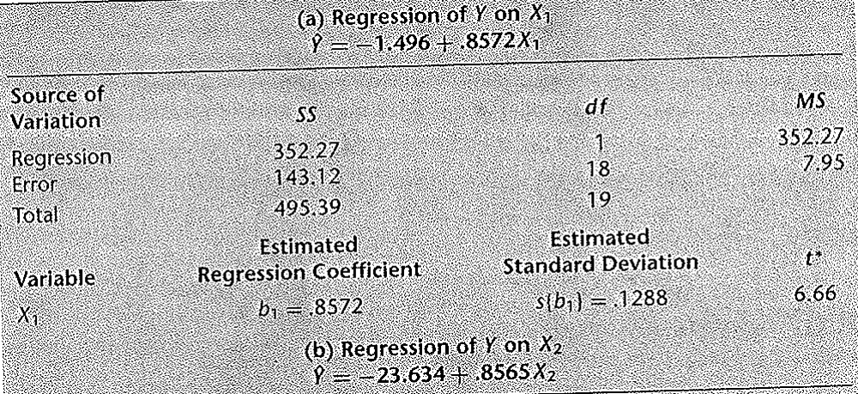
Extra
Sums of Squares
That is, the reduction in the error sums of squares by adding X₂ into the model which already contained X₁, or the increase in SSR, is called the extra sum of squares.
We have that SSR(X₁) = 352.27 and SSE(X₁) = 143.12

Slide 4
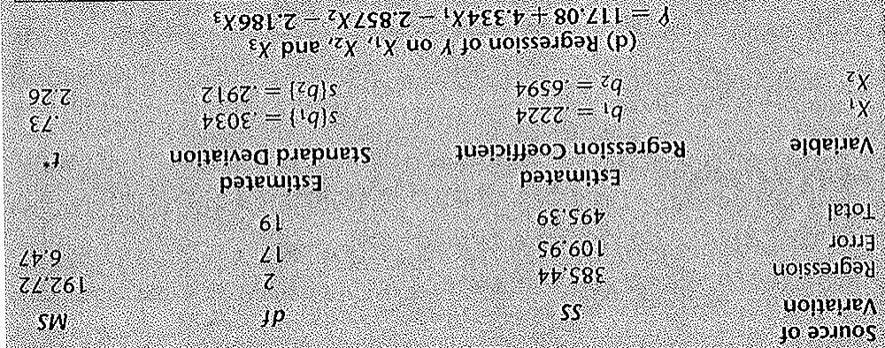
Extra
Sums of Squares
When both X₁ and X₂ are in the model, SSR(X₁,X₂) = 385.44 and SSE(X₁,X₂) = 109.95. Note that the increase in SSR by adding X₂ is the same as the decrease in SSE.
SSR(X₁,X₂) - SSR(X₁) = 385.44 - 352.27 = 33.17
SSE(X₁) - SSE(X₁,X₂) = 143.12 – 109.95 = 33.17

Slide 5
Extra
Sums of Squares
The extra sums of squares is this marginal increase in the regression sum of squares achieved by adding X₂ to the model which already has X₁.
Equivalently, it is the marginal reduction is the error sums of squares achieved by adding X₂ to the model which already has X₁.
Thus, SSR(X₂|X₁) = SSE(X₁) – SSE(X₁,X₂) = SSR(X₁,X₂) - SSR(X₁) = 33.17
The notation SSR(X₂|X₁) reflects the marginal effect of adding X₂ to the model given that X₁ is already in the model.

Slide 6
Extra
Sums of Squares
The reason that the reduction in SSE is the same as the increase in SSR comes from the basic ANOVA identity
SSTO = SSR + SSE
The total variability in the responses (SSTO) is unchanged when we add a new predictor to the model.
Thus any increase in SSR must equal the same decrease in SSE.
We can consider other extra sums of squares, such as the marginal effects of adding X₃ to a model that already has X₁ and X₂. That is SSR(X₃|X₁, X₂).

Slide 7
Extra
Sums of Squares
We can also consider the marginal effects of adding several variables, such as adding both X₂ and X₃ to a model already containing X₁
SSR(X₂,X₃|X₁) = SSE(X₁) – SSE(X₁,X₂,X₃)
or equivalently
SSR(X₂,X₃|X₁) = SSR(X₁,X₂,X₃) – SSR(X₁)
In multiple regression, we can obtain a variety of decompositions of the regression sum of squares SSR into extra sums of squares.
We will consider the case with two X variables, X₁ and X₂.

Slide 8
Extra
Sums of Squares
We begin with the ANOVA identity for X₁:
SSTO = SSR(X₁) + SSE(X₁)
Since SSR(X₂|X₁) = SSE(X₁) – SSE(X₁,X₂), we can rewrite this as
SSTO = SSR(X₁) + SSR(X₂|X₁) + SSE(X₁,X₂)
The ANOVA identity when both X₁ and X₂ are in the model is
SSTO = SSR(X₁,X₂) + SSE(X₁,X₂)
We can rewrite this as
SSR(X₁,X₂) = SSTO - SSE(X₁,X₂)

Slide 9
Extra
Sums of Squares
Plugging in our earlier result for SSTO, we obtain
SSR(X₁,X₂) = SSR(X₁) + SSR(X₂|X₁) + SSE(X₁,X₂) - SSE(X₁,X₂)
or
SSR(X₁,X₂) = SSR(X₁) + SSR(X₂|X₁)
Thus we have decomposed the regression sum of squares SSR(X₁,X₂) into two marginal components:
SSR(X₁), measuring the contribution by including X₁ alone in the model.
SSR(X₂|X₁), measuring the additional contribution when X₂ is included, given that X₁ is already in the model.

Slide 10
Extra
Sums of Squares
The order of the predictor variables is arbitrary. We could also obtain
SSR(X₁,X₂) = SSR(X₂) + SSR(X₁|X₂)
The following figure on the next slide shows schematic representations of these two decompositions of SSR(X₁,X₂) for the body fat example.
The total of both bars represents SSTO and the bar on the left represents the second decomposition (on this slide) while the bar on the right represents the first decomposition (on the previous slide) .

Slide 11
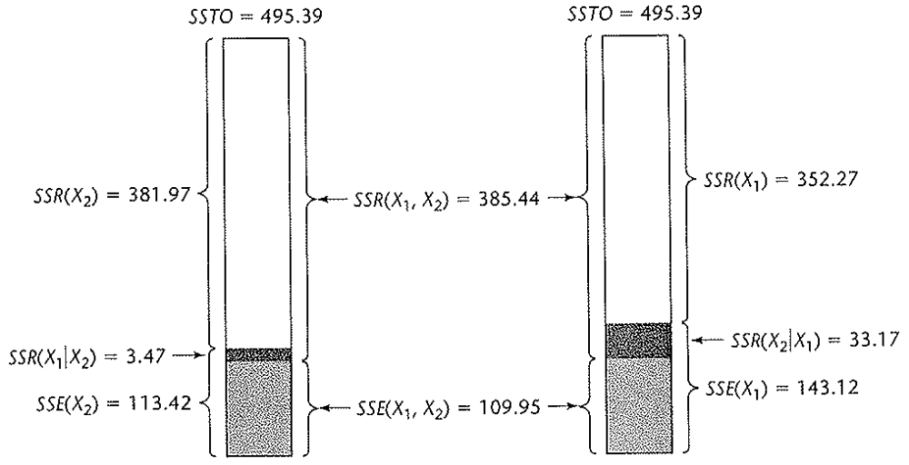
Extra
Sums of Squares
For the first bar, the unshaded component is SSR(X₂), and the combined shaded area is SSE(X₂).
Note that SSR(X₁|X₂) is equal to the error sum of squares SSE(X₂), when just X₂ is in the model, minus the error sum of squares SSE(X₁,X₂), when both X₁ and X₂ are in the model.

Slide 12
Extra
Sums of Squares
Also note that the total part explained by having both X₁ and X₂ in the model, SSR(X₁,X₂), is equal to the part explained with just X₂ in the model, SSR(X₂), plus the additional part explained by adding X₁ to the model, given X₂ is already in the model, SSR(X₁|X₂). That is SSR(X₁,X₂) = SSR(X₂) + SSR(X₁|X₂).

Slide 13
Extra
Sums of Squares
In both decompositions, the extra sums of squares can be viewed as either the reduction in the error sums of squares or as the increase in the regression sum of squares when the second predictor variable is added to the model.
When the regression model contains three X variables, several decompositions of SSR(X₁,X₂,X₃) can be obtained. Below are 3 of them:
SSR(X₁,X₂,X₃) = SSR(X₁) + SSR(X₂|X₁) + SSR(X₃|X₁,X₂)
SSR(X₁,X₂,X₃) = SSR(X₂) + SSR(X₃|X₂) + SSR(X₁|X₂,X₃)
SSR(X₁,X₂,X₃) = SSR(X₁) + SSR(X₂,X₃| X₁)
The number of possible decompositions becomes rather large as the number of predictor variables in the model increases.

Slide 14
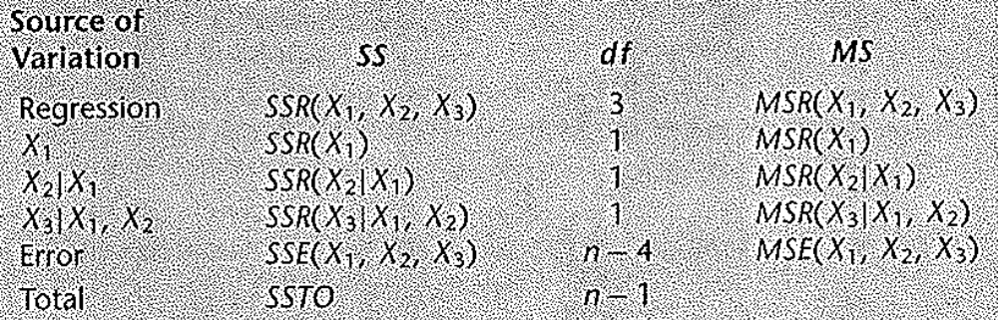
Extra
Sums of Squares
ANOVA tables containing decompositions of the regression sum of squares into extra sums of squares can be constructed.
The below table contains the ANOVA table decomposition for three X variables that is most commonly used. The decomposition involves adding single extra X variables.

Slide 15
Extra
Sums of Squares
Note that each extra sum of squares involving a single extra X variable has one degree of freedom associated with it.
The mean squares are constructed as usual; by dividing the sums of squares by the degrees of freedom. Thus here, the mean squares are the same as the extra sum of squares.
Extra sums of squares involving two extra X variables, such as SSR(X₂,X₃|X₁) have two degrees of freedom associated with them.
This follows because we can express such extra sum of squares as the sum of two extra sum of squares, each with one degree of freedom.

Slide 16
Extra
Sums of Squares
For example, by the definition of the extra sums of squares, we have
SSR(X₂,X₃|X₁) = SSR(X₂|X₁) + SSR(X₃|X₁,X₂)
The mean square MSR(X₂, X₃| X₁) is then SSR(X₂, X₃| X₁)/2
Many computer packages provide decompositions of the SSR into single degree of freedom extra sums of squares, usually in the order which the X variables are entered into the model.
Thus if the X variables are entered in the order X₁,X₂,X₃, the extra sums of squares given in the output are
SSR(X₁)
SSR(X₂|X₁)
SSR(X₃|X₂,X₁)

Slide 17
Extra
Sums of Squares
If the extra sum of squares involving several X variables is desired, it can be obtained by summing the appropriate single degree of freedom sums of squares.
For instance, to obtain SSR(X₂,X₃|X₁), we simply add SSR(X₂|X₁) and SSR(X₃|X₁,X₂).
If the extra sum of squares SSR(X₁,X₃|X₂) were desired, we can get this by adding SSR(X₁|X₂) and SSR(X₃|X₁,X₂).
Thus the X variables need to be entered in the order X₂,X₁,X₃, giving the extra sums of squares
SSR(X₂)
SSR(X₁|X₂)
SSR(X₃|X₁,X₂)

Slide 18
SAS MULTIPE-SS1

